Slide 1
Disclosure Statement of Financial Interest
I have no conflicts regarding this talk

Slide 2
ENDPOINTS FOR MITRAL/TRICUSPID DEVELOPMENT
BLASE CARABELLO AHA/ACC GUIDELINES, JOHN LASCHINGER FDA, SHARON SAEGER PATIENT, PATRICK VERTA ,EDWARDS, JOHN WEBB ST PAUL’S

Slide 3
PRIMARY AND SECONDARY MR ARE 2 DIFFERENT DISEASES
AND MUST BE TREATED AS SUCH

Slide 4
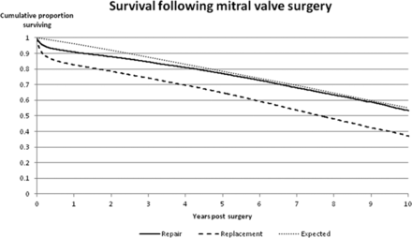
VASSILEVA et al CIRC: 2013

Slide 5
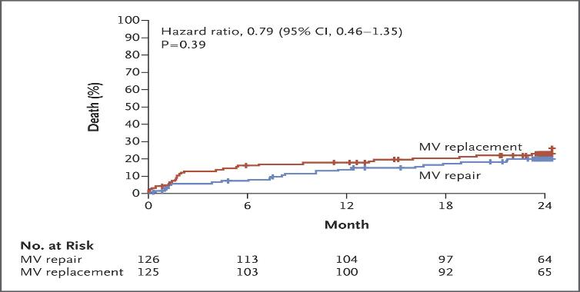
Goldstein D et al. N Engl J Med 2015.

Slide 6
EVEN WITHIN THOSE 2 CLASSIFICATIONS THERE ARE SUBSETS

Slide 7
WHAT ARE THE GOALS OF THE THERAPY FOR:
45 Y/O MAN, WIDE OPEN MR FROM P₂ PROLAPSE, EF 70 %, RUNNING 5 MILES/DAY. GOLD STANDARD IS A DURABLE REPAIR AND NORMAL LIFE SPAN
50 Y/O WOMAN, +4 MR, SEVERE RHEUMATIC DEFORMITY, CLASS III SYMPTOMS. GOLD STANDARD IS MVR (WHAT TYPE?) SHORTENED LIFE SPAN
75 Y/O SEVERE PRIMARY MR; CLASS III SYMPTOMS, INOPERABLE DUE TO COMORBIDITIES
GOLD STANDARD IS MEDICAL Rx. GOAL IS IMPROVED QOL
75 Y/O WOMEN, S/P 3 MIs EF 25 %, INTRACTABLE HF, SEVERE SECONDARY MR, 4 HF HOSPITALIZATIONS THE PAST Yr. GOLD STANDARD IS MEDICAL Rx. GOAL IS IMPROVED QOL

Slide 8
THE GENERAL DOMAINS OF OUTCOMES
SAFETY
EFFECTIVENESS

Slide 9
SAFETY
PROCEDURAL MORTALITY
DEVICE FAILURE (MISPLACEMENT, EMBOLIZATION, ETC)
STROKE
LEAK
HEMOLYSIS
UNANTICIPATED COLLATERAL PROCEDURES
ACCESS-RELATED COMPLICATIONS

Slide 10
EFFECTIVENESS
LONG TERM SURVIVAL
REDUCTION vs CORRECTION OF MR
LV FUNCTION
REHOSPITALIZATIONS FOR HF
SYMPTOMS
QOL

Slide 12
THE DIFFERENCES IN THE PATIENTS REQUIRE A HIERARCHICAL APPROACH
AND THE HIERARCHY WILL DIFFER

Slide 13
45 Y/O MAN WITH SEVERE ASYMPTOMATIC MR: THE BAR IS VERY HIGH
DURABLE MITRAL REPAIR IS THE GOLD STANDARD
< 1% PROCEDURE-RELATED MORTALITY
NORMAL LIFESPAN
<1%/yr RETURN OF > 2+ MR
NORMAL QOL WITHOUT RESTRICTIONS OR MEDICATION

Slide 14
OUTCOME SUCCESS OF A NEW DEVICE WILL BE JUDGED BY A TRADITIONAL HEIRARCHY
SURVIVAL
DURABILITY
MORBIDITY
EASE AND SAFETY OF IMPLANTATION
COST

Slide 15
75 Y/O WOMEN, S/P 3 MIs EF 25 %, INTRACTABLE HF, SEVERE SECONDARY MR, 4 HF HOSPITALIZATIONS THE PAST Yr.: THE BAR IS LOW
NO EVIDENCE WE CAN PROLONG HER LIFE
NO ACCEPTED METHOD OF CORRECTING HER MR
GOAL: THE DEVICE MUST BE SAFE
REDUCE THE NUMBER OF HOSPITALIZATIONS AND IMPROVE SYMPTOMS AND QOL

Slide 16
HER OUTCOME WILL BE JUDGED USING A DIFFERENT HEIRARCHY
NYHA CLASS
QOL
6 MINUTE WALK
HOSPITALIZATIONS

Slide 17
CLASSIC ENDPOINT
MORTALITY, MI, STROKE

Slide 18
ALTERNATIVE METHOD
Finklestein-Schoenfeld (FS) analysis or a variation of it, the Win-ratio

Slide 19
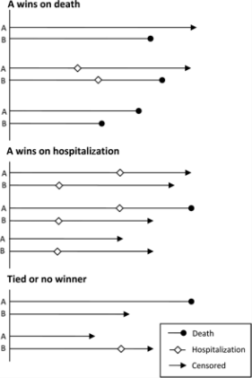
From: The win ratio: a new approach to the analysis of composite endpoints in clinical trials based on clinical priorities
Eur Heart J. 2011;33(2):176-182. doi:10.1093/eurheartj/ehr352
Eur Heart J | Published on behalf of the European Society of Cardiology. All rights reserved. © The Author 2011. For permissions please email: journals.permissions@oup.com
Notes:
Figure 1 A conceptual diagram illustrating possible scenarios for the win ratio method.
19

Slide 21
END POINTS FOR PRIMARY MR

Slide 22
NATURAL AND POST SURGICAL HISTORY WELL DEFINED
SURVIVAL
DURABILITY
EASE OF IMPLANTATION
HOSPITAL STAY
COST

Slide 23
SECONDARY MR
SURVIVAL IS SHORT
HOSPITALIZATIONS FREQUENT

Slide 24
ENDPOINTS
SAFETY OF IMPLANTATION
QOL
NYHA CLASS
HOSPITALIZATION

Slide 25
TRICUSPID REGURGITATION

Slide 26
NATURAL HISTORY POORLY DEFINED
HARD TO DEFINE ENDPOINTS
SECONDARY TR MUCH MORE COMMON THAN PRIMARY SO THAT THE PRIMARY DISEASE, NOT TR IS THE KEY DRIVER

Slide 27
NOT CLEAR WHAT THE COMPARATOR SHOULD BE

Slide 28
SAFETY
PROCEDURAL MORTALITY
DEVICE FAILURE (PLACEMENT, EMBOLIZATION, ETC)
LEAK
HEMOLYSIS
UNANTICIPATED COLLATERAL PROCEDURES
ACCESS-RELATED COMPLICATIONS

Slide 29
EFFECTIVENESS
LONG TERM SURVIVAL (UNLIKELY ENDPOINT)
REDUCTION vs CORRECTION OF TR
RV FUNCTION (WHAT IS NORMAL? WHAT IS ACCEPTABLE?)
REHOSPITALIZATIONS FOR HF
SYMPTOMS
QOL

Slide 30
ENDPOINTS FOR TR
SAFE DELIVERY
MEASURABLE REDUCTION IN TR
IMPROVED QOL

