Slide 1
Endpoints for Aortic Valve Development
Ori Ben-Yehuda, MD
Cardiovascular Research Foundation
New York, NY

Slide 2
Disclosure Statement of Financial Interest
I, Ori Ben-Yehuda, DO NOT have a financial interest/arrangement or affiliation with one or more organizations that could be perceived as a real or apparent conflict of interest in the context of the subject of this presentation.

Slide 3
TAVR Trials: The Initial Trials
Comparison to SAVR
High Surgical Risk
Intermediate Risk
Comparison to medical therapy
Inoperable Patients
Population with high hard point event rates- mortality and stroke

Slide 4
The Current/Next Stage in TAVR Studies
Lower Risk
Asymptomatic
Earlier in the disease process- moderate AS
What are the most relevant endpoints?
Can sample size be reduced?

Slide 5
EARLY- TAVR
Asymptomatic patients with Severe AS
Not a specifically surgically low risk population
N=1109
Primary Endpoint: non-hierarchal -all-cause death or stroke or unplanned cardiovascular hospitalization
Secondary Endpoint: death or disabling stroke
clinicaltrials.gov (NCT03042104)

Slide 6
Partner 3: Low Risk AS patients
STS<4
N=1328 patients; randomized to surgery vs. TAVR (transfemoral)
Primary Endpoint: All-cause mortality, all stroke, and re-hospitalization
This composite endpoint will be evaluated as a non-inferiority analysis based on a relative non-inferiority margin of 35%
clinicaltrials.gov (NCT02675114)

Slide 7
Newer Devices- what pathway, what endpoints?
Non-inferiority design for total mortality and stroke
Reasonable relative margin
Secondary endpoints may differentiate among devices
Rate of PVL
Rate of PPM
Vascular Complications (low profile; smaller sheaths, etc…)

Slide 8
Surrogate Endpoints
Pros’s
Every patient contributes to endpoint
Important endpoints for patients (eg, QoL)
Shorter follow-up
Con’s
Associated but not necessarily causal with hard endpoints
Difficult to combine into a composite endpoint

Slide 9
Type of Surrogate Endpoints Applicable to TAVR
Imaging
Echo- Reduction in stenosis, valve regurgitation, etc., EF
MRI- Reduction in LVH, Infarct Size
Exercise endpoints
6MWT, ETT, CPET
Quality of Life
Generic- SF-36/SF-12, EQ-5
Disease specific- SAQ, MLWHFQ, KCCQ
Biomarkers
NT-NBP

Slide 10
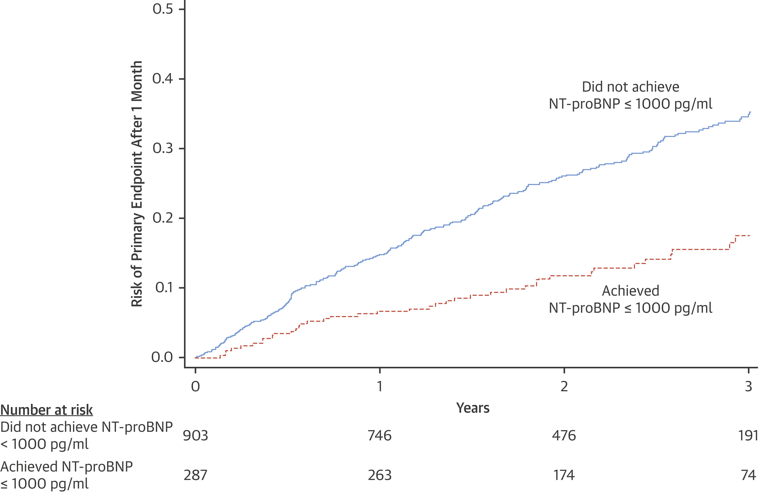
NT-proBNP in PARADIGM

Slide 11
NT-proBNP in PARADIGM: Effect of Treatment

Slide 12
Heart Failure Hospitalization Equivalents
Okumura et al. Circulation 2016; 133:2254-2262

Slide 13
Heart failure event
Symptoms New or Worsening | Physical Examination New or Worsening | Laboratory Data New or Worsening
Criterion for new or worsening symptoms due to HF is to have at least 1 of the following on presentation: a) Dyspnea b) Decreased exercise tolerance c) Fatigue d) Worsened end-organ perfusion e) Volume overload | Criterion for new or worsening objective findings due to HF includes at least 2 physical examination findings OR 1 physical examination finding and at least 1 laboratory criterion. Physical examination findings include new or worsened: a) Peripheral edema b) Increasing abdominal distention or ascites c) Pulmonary rales/crackles/crepitations d) Increased jugular venous pressure and/or hepatojugular reflux e) S3 gallop f) Clinically significant or rapid weight gain thought to be related to fluid retention | Documentation of new or worsening laboratory evidence of HF obtained within 24 h of patient presentation. Criterion for new or worsening objective findings due to HF includes at least 2 physical examination findings OR 1 physical examination finding and at least 1 laboratory criterion. Laboratory criteria include new or worsened: a) Increased BNP/NT-proBNP b) Radiological evidence of pulmonary congestion c) Noninvasive diagnostic evidence of HF d) Invasive diagnostic evidence of HF
Hicks et a. 2017 Cardiovascular and Stroke Endpoint Definitions for Clinical Trials. Circulation. 2018;137:961–972.

Slide 14
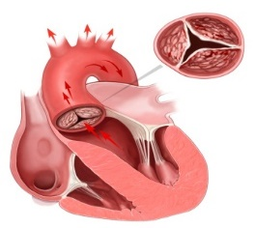
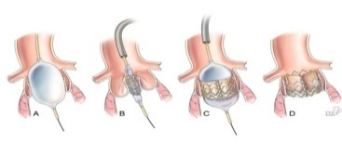
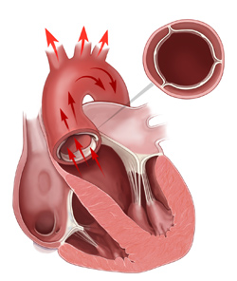
TAVR UNLOAD Concept
Follow-up:
1, 6 months
1 & 2 years
Clinical endpoints
Symptoms
Echo
QoL
TAVR UNLOAD Trial
TAVR + OHFT
LV-EF< 50%
&
Moderate AS
R
International
Multicenter
Randomized
OHFT alone
Spitzer et al. AHJ 2016;182:80-88

Slide 15
Integrating Surrogates into Composite Endpoints
Composite endpoints are problematic- even for hard endpoints
eg: Death, Stroke, MI; mortality and hospitalization
Even more challenging for surrogate endpoints, esp with hardpoints
e.g: hospitalization plus improvement in KCCQ!
How does one combine into a single endpoint?

Slide 16
Finkelstein-Schoenfeld Methodology
Hierarchal Composite Endpoint
Clinically relevant
Allows for combination of hard endpoints (mortality, stroke, re-hospitalizations) and softer but clinically relevant endpoints such as QoL and Functional Status

Slide 17
Finkelstein-Schoenfeld Methodology: A solution to the Composite Endpoint Problem
Hierarchy created for endpoints
May include disparate types- eg mortality and quality of life
Each patient in Arm A is compared with each patient in Arm B
For each patient comparison and endpoint in the hierarchy a win, loss, or tie is declared
If a win (and corresponding loss for the other patient) is declared no need to continue to lower tier in the hierarchy
If a tie is declared, one continues to a lower tier
Number of wins is counted in each group

Slide 18
TAVR- UNLOAD: FS Methodology
Comparison of each potential subject pair (1 from TAVR group and 1 from OHFT) | How event is assessed
Step 1 If 1 or both subjects die Subject in TAVR group dies first Subject in OHFT group dies first Both subjects die on the same day Step 2 If no ranking yet available Subject in TAVR group suffers a more severe disabling stroke (mRS 2 to 5) Subject in OHFT group suffers a more severe disabling stroke (mRS 2 to 5) Both subjects suffer a disabling stroke of the same severity Step 3 If no ranking yet available Subject in TAVR group suffers the stroke first Subject in OHFT group suffers the stroke first Both subjects suffer a disabling stroke of the same severity on the same day -------------------------------------------------------------------------------------------------------- Step 6 If no ranking yet available Subject in TAVR group is in worse KCCQ category at one year** Subject in OHFT group is in worse KCCQ category at one year Both subjects are in same KCCQ category at one year | Favors OHFT Favors TAVR Go to step 2 Favors OHFT Favors TAVR Go to step 3 Favors OHFT Favors TAVR Go to step 4 Favors OHFT Favors TAVR Tie

